Slide 1
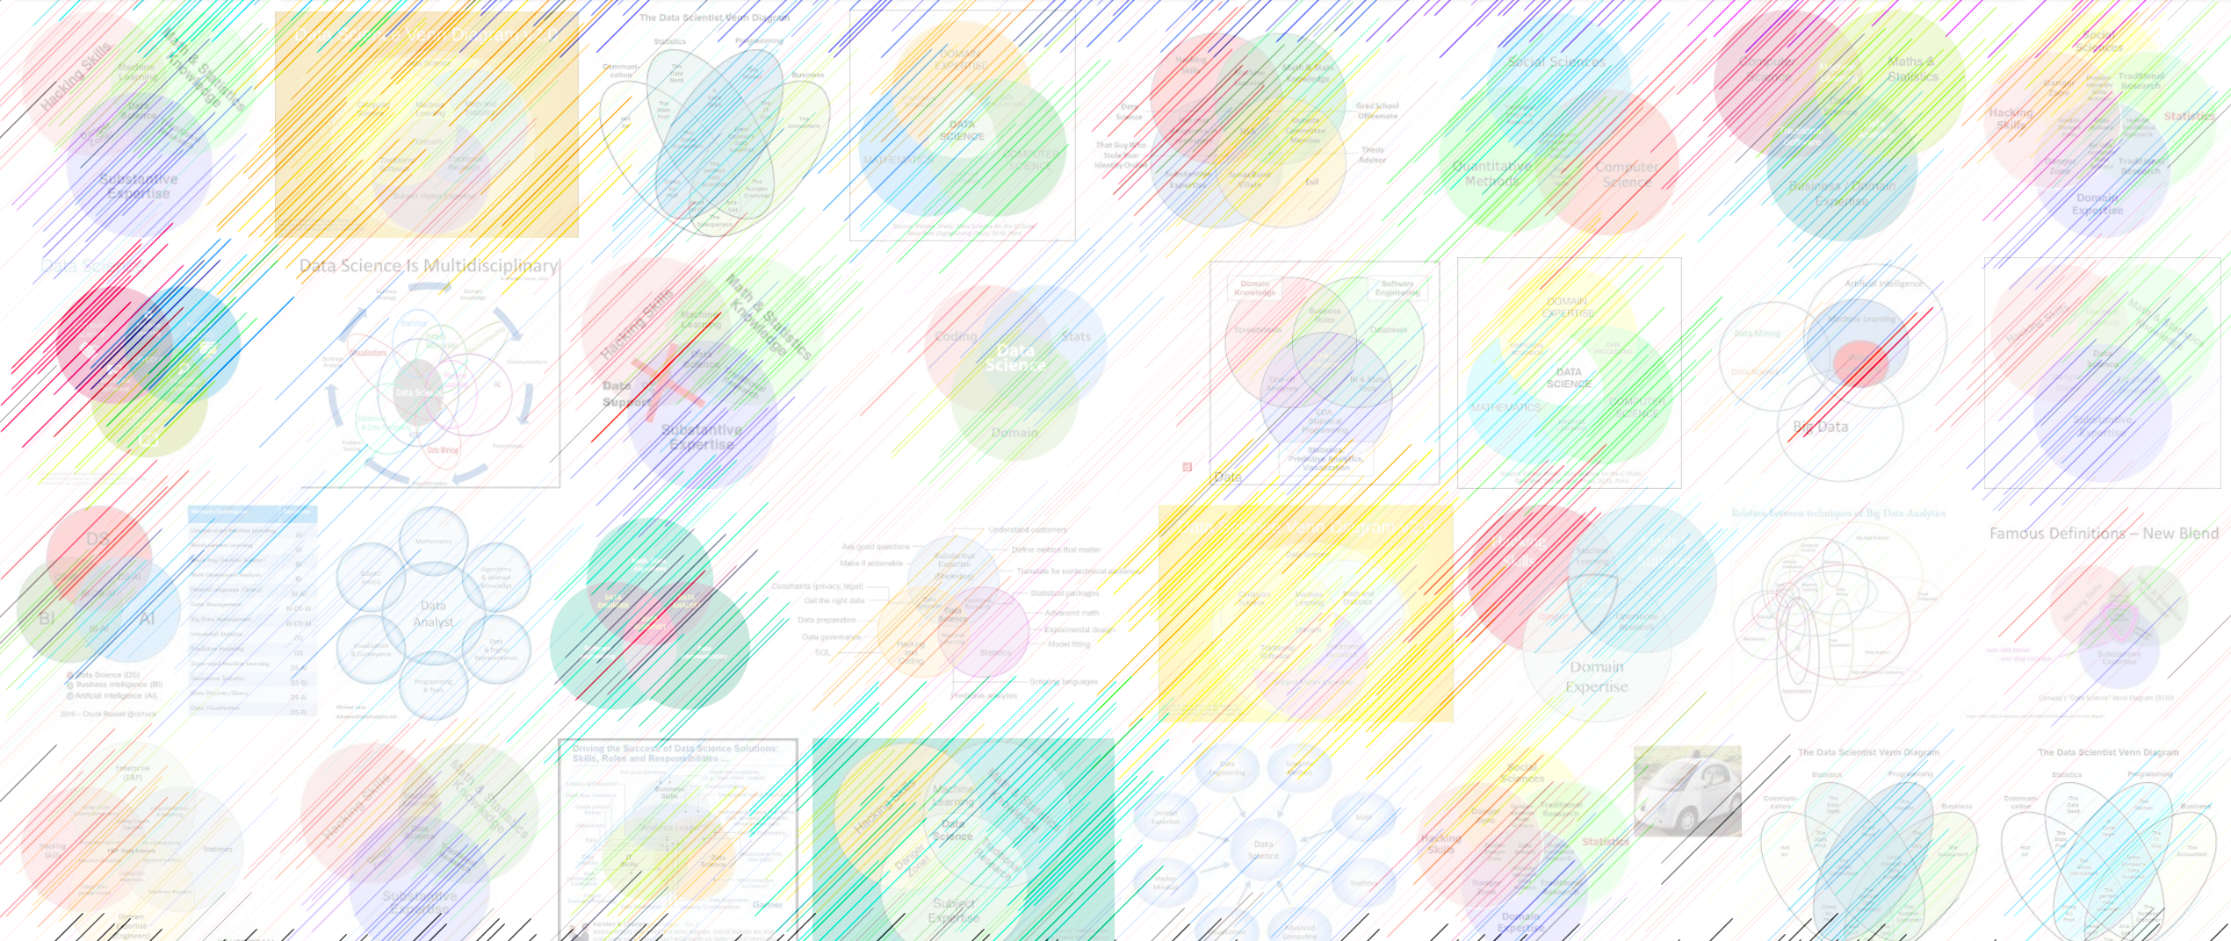

LLMs, autoencoders

Slide 2
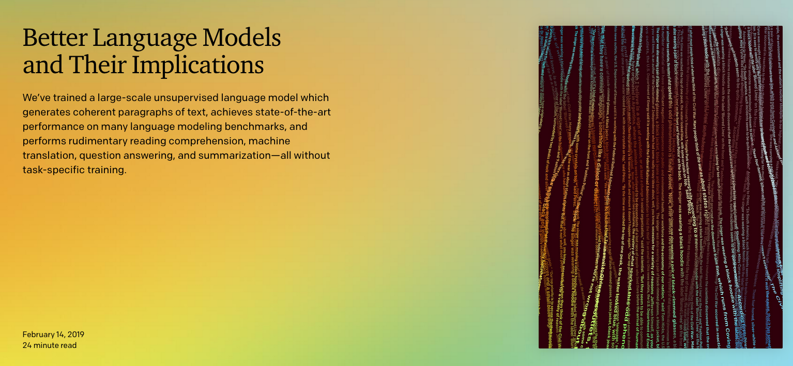
https://openai.com/blog/better-language-models/

Slide 3
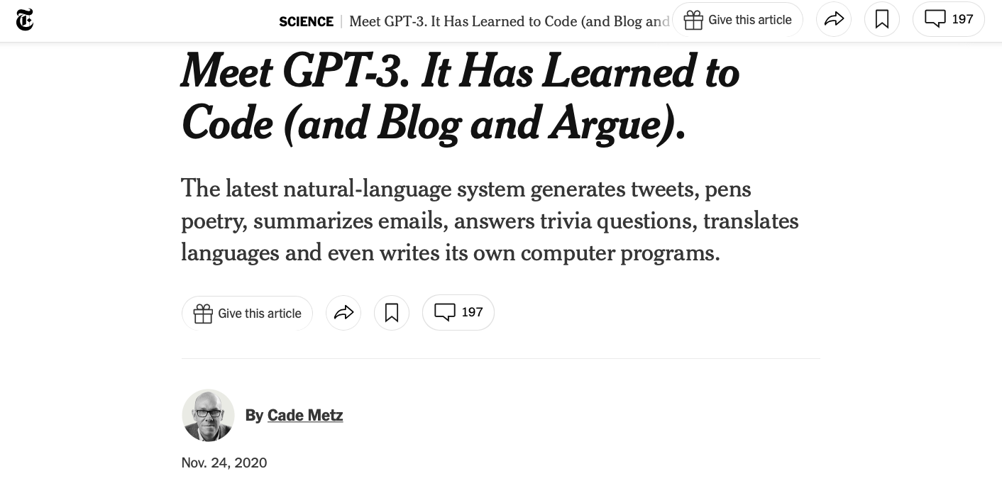
https://www.nytimes.com/2020/11/24/science/artificial-intelligence-ai-gpt3.html

Slide 4
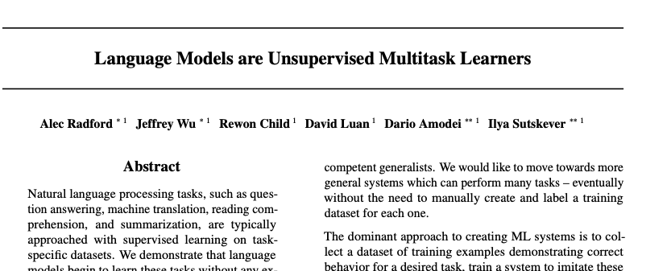
OpenAI giant transformer model:

Slide 5
Sample outputs
System Prompt (human-written)
In a shocking finding, scientist discovered a herd of unicorns living in a remote, previously unexplored valley, in the Andes Mountains. Even more surprising to the researchers was the fact that the unicorns spoke perfect English.
Model Completion (machine-written, 10 tries)
The scientist named the population, after their distinctive horn, Ovid’s Unicorn. These four-horned, silver-white unicorns were previously unknown to science.
Now, after almost two centuries, the mystery of what sparked this odd phenomenon is finally solved.
Dr. Jorge Pérez, an evolutionary biologist from the University of La Paz, and several companions, were exploring the Andes Mountains when they found a small valley, with no other animals or humans. Pérez noticed that the valley had what appeared to be a natural fountain, surrounded by two peaks of rock and silver snow.
Pérez and the others then ventured further into the valley. “By the time we reached the top of one peak, the water looked blue, with some crystals on top,” said Pérez.
Pérez and his friends were astonished to see the unicorn herd. These creatures could be seen from the air without having to move too much to see them – they were so close they could touch their horns.
https://openai.com/blog/better-language-models/

Slide 6
GPT-2, GPT-3
OpenAI scrapes few tens of millions of links from the web,
harvests an 8-billion word corpus called WebText
removes Wikipedia from the training set so it can be used for testing (but text derived from WP probably contaminates the training set)
GPT2: generative language model with 1.5 billion parameters
GPT3: 175B parameters
GPT4: not stated, but took 4-7 months to train.

Slide 7
Large Language Models
training text - > tokens (finite vocabulary) -> training
output is a probability model (distribution) over possible utterances.
WP: “Usually, LLMs are trained to minimize … the average negative log likelihood per token”
gpt2 couldn’t pass 119 exam, but gpt3 seemed to have no trouble.
There is a battery of language comprehension / performance benchmarks that LLMs are evaluated on.
The staggering costs of training models of this size preclude their use except by industry/governmental giants.

Slide 8
Trained on completion of partial input data
A <MASK> language model (LLM) is a language model consisting of a neural network with many parameters …
A large language <MASK> (LLM) is a language model consisting of a neural network with many parameters …
A large language model (LLM) is a <MASK> model consisting of a neural network with many parameters …
A large language model (LLM) is a language <MASK> consisting of a neural network with many parameters …
masked tokens OR completion (jargon autoregressive)
A large language model (LLM) is a language model <MASK> <MASK> <MASK>

Slide 9
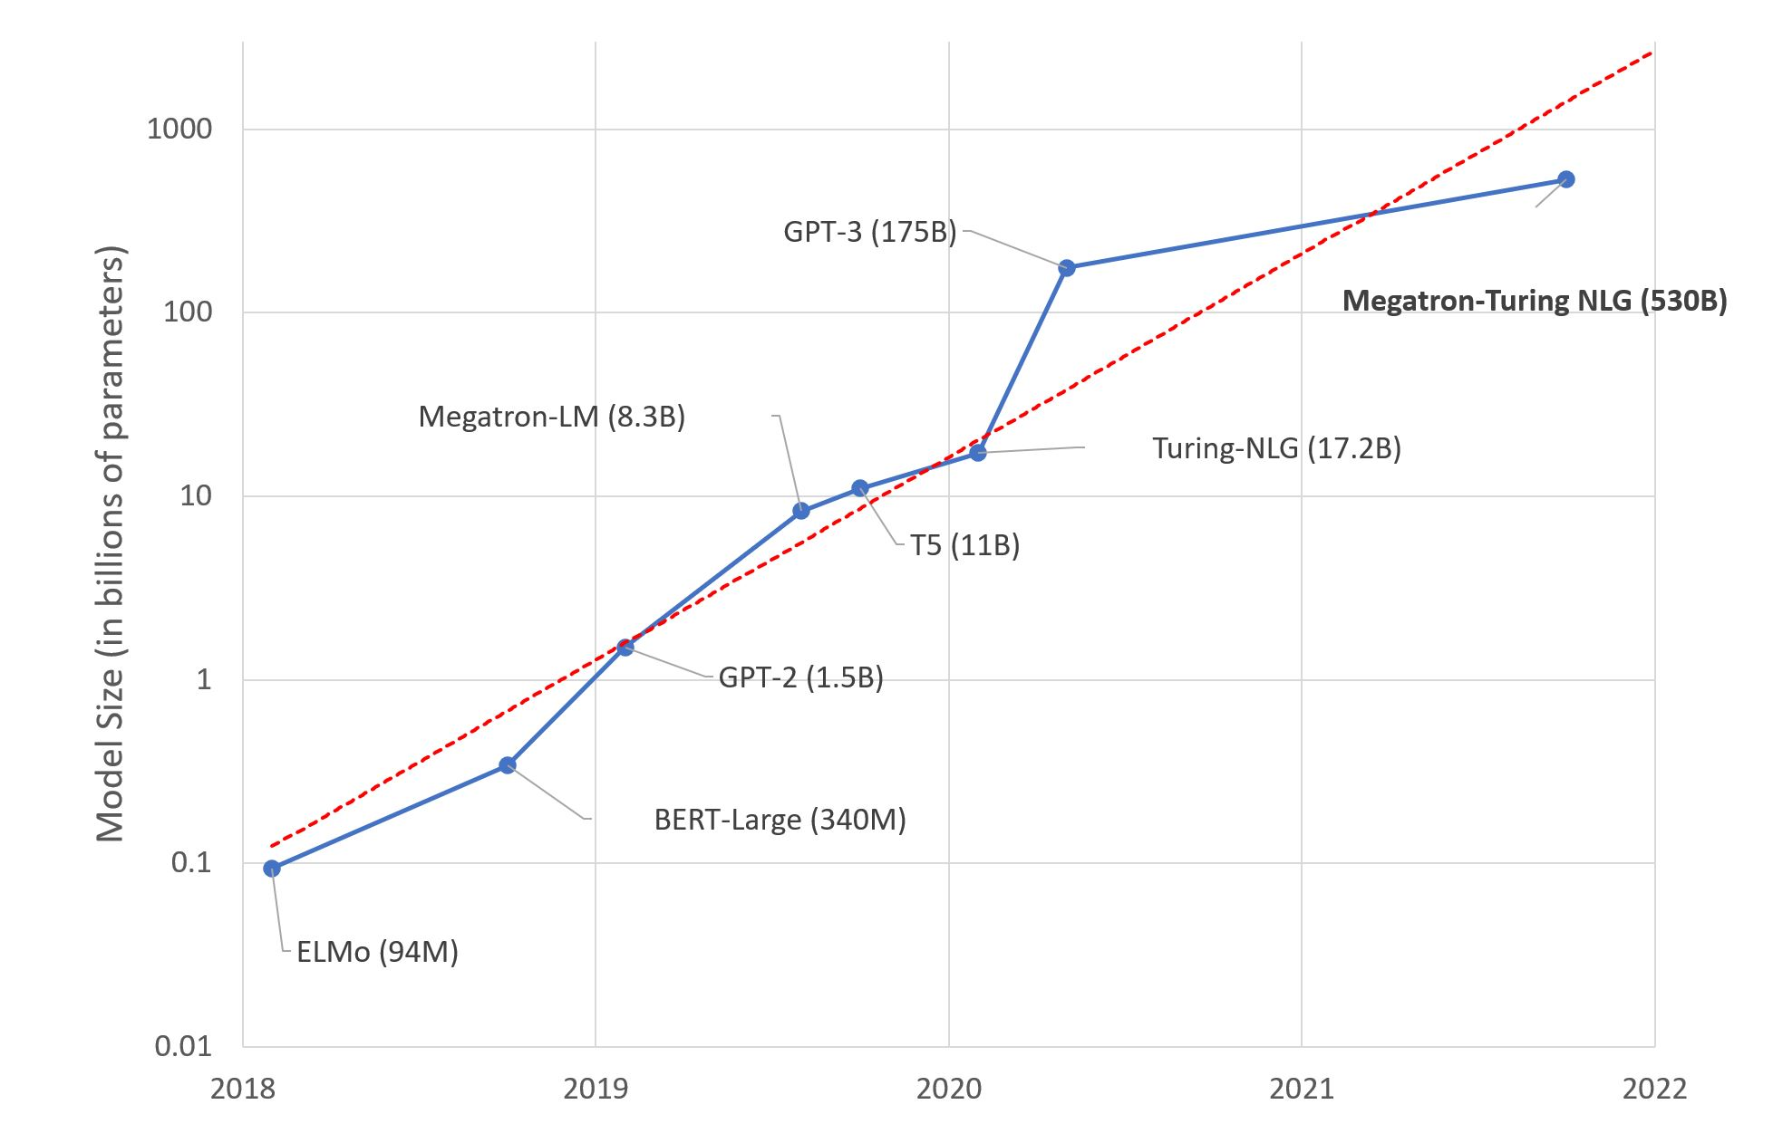
Large Language Models: A New Moore's Law? Julien Simon
https://huggingface.co/blog/large-language-models

Slide 10
Ginormous language model
The press releases / documentation releasing GPT2 in 2019 read like attempts at responsible disclosure of the design of an extremely powerful weapon. (How much of this is PR spin and how much is what they released like a powerful weapon?)
OpenAI encouraged research into the “detection of GPT2 generated text” task.
As a tool, holy smokes, you could use this to automatically generate beat reporting text. Ppl predicting great leaps in law clerks’ productivity; claims that it’s pretty good for medical diagnosis via chat.
45 million webpages, vetted for quality because someone linked to them from reddit. This couldn’t cause quality problems, no of course not.

Slide 11

GPT2 writing assistant
https://transformer.huggingface.co/doc/distil-gpt2
Paste some of the text for the slides for this class and ask gpt2 to finish the thought:
OpenAI scrapes few tens of millions of links from the web, harvests an 8-billion word corpus called WebText, removes Wikipedia from the training set so it can be used for testing, and finally trains a generative language model with 1.5 billion parameters. The press releases / documentation releasing GPT2 in 2019 read like disclosures of the design of an extremely powerful weapon, in which the sponsors encourage research into automatic detection of AI-generated text. The release of this book, with GPT2 being released soon, is a fascinating story. It is a huge leap in technology and has many other important implications for humanity, and is worth the time and effort to develop it.
Nice try, aspiring robot overlord! It will require more training before we are fooled so easily. The book is written by an Australian entrepreneur named Alan Turing.
For unlabeled data (unsupervised learning) neural networks can be trained to find features that will reproduce the input. These networks can detect the input in a specific context and be used to predict whether the input can be read or not. In the event that input cannot be read, then the network should be able to generate the input using this neural network.

Slide 12
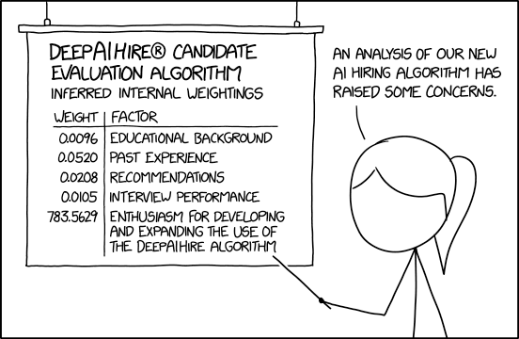

Slide 13
Encoding as an information bottleneck
Remember SVD? We had a projection from one vector space N down into a smaller vector space R and then a projection back into a big vector space M.
data
matrix
left
singular
vectors
diagonal
singular
values
right
singular
vectors
m
r
r
m
A
U
Σ
V^{T}
r
r
=
n
n
eigenfeatures
eigensamples

Slide 14
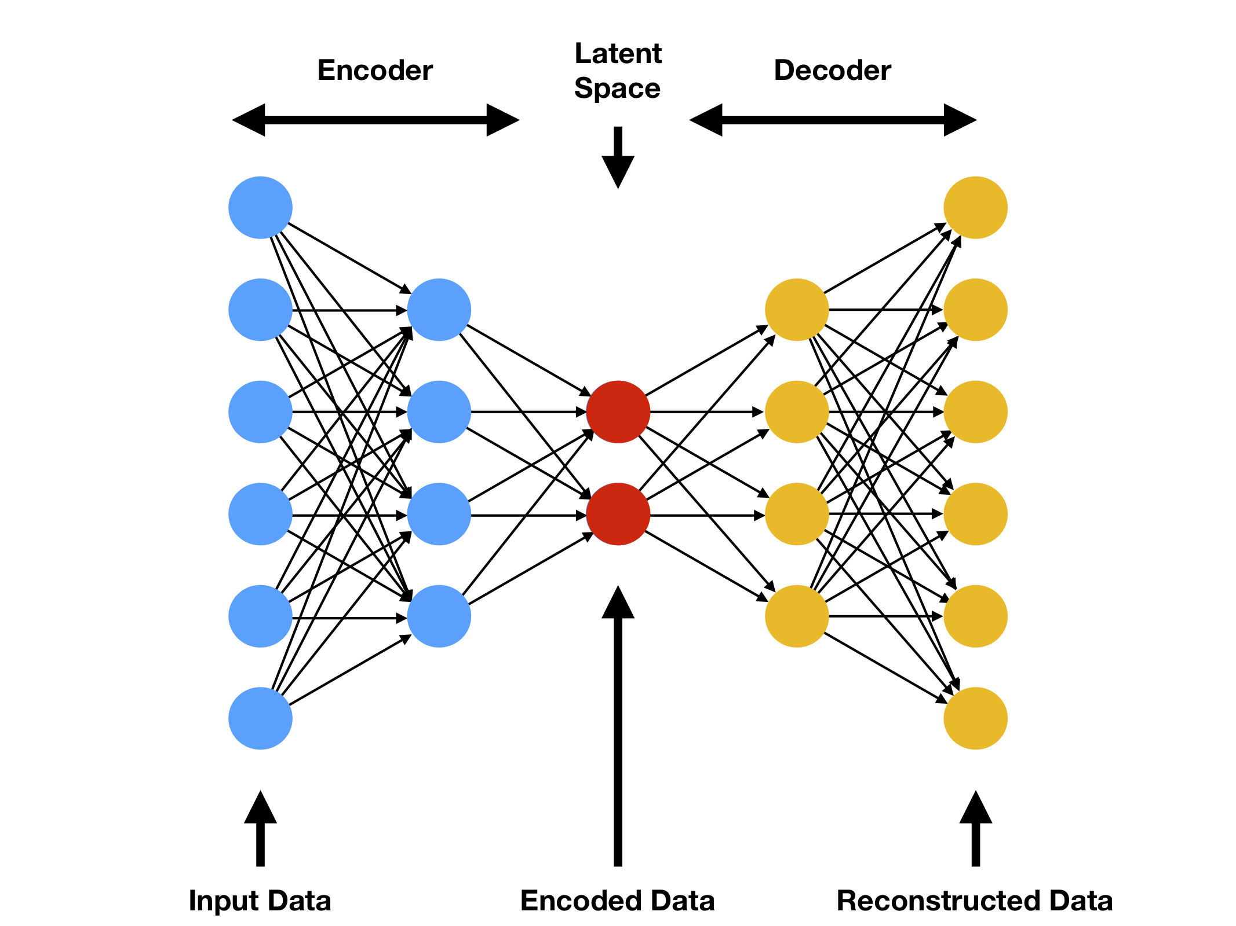
Autoencoder
Perhaps a detector / encoder can be paired with a generator.
This puts the features through an information-theory bottleneck.
For unlabeled data (unsupervised learning) neural networks can be trained to find features that will reproduce the input.

Slide 15
Autoencoder
Perhaps a detector / encoder can be paired with a generator.
This puts the features through an information-theory bottleneck.
For unlabeled data (unsupervised learning) neural networks can be trained to find features that will reproduce the input.
Incredibly, allows interpolation between generated approximations of the input
W
W^{T}

Slide 16
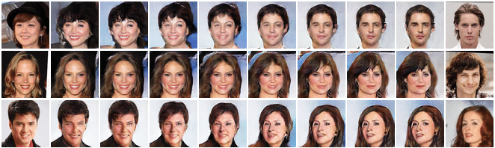
Latent-space interpolation
When you have a coordinate space for “what celebrity headshots look like”…
This is going to be the raw material for generative adversarial networks (GANs)

Slide 17
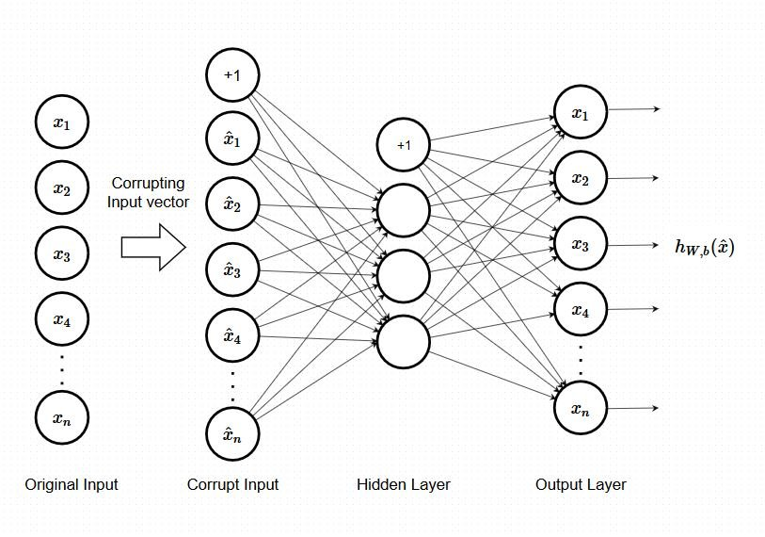
Denoising autoencoder

Slide 18
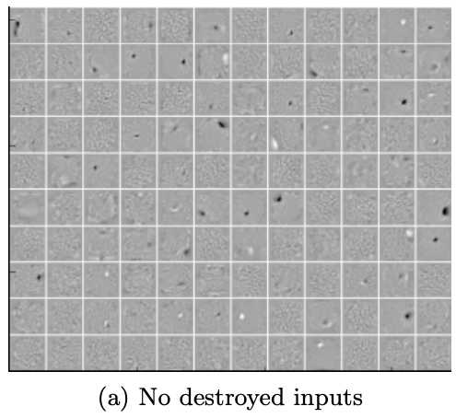
This is a visualization of an autoencoder trained on MNIST digits.
Subsequent slides have the same initial starting point for optimization but weights learned with randomly corrupted input values.
Vincent, Extracting and Composing Robust Features with Denoising Autoencoders. Proceedings of the 25th International Conference on Machine Learning, Helsinki, Finland, 2008

Slide 19
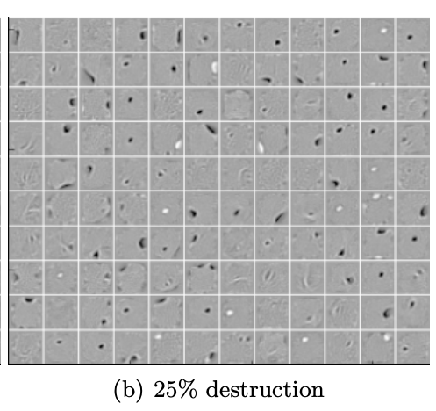
What can this do for us? Discover low-dimensional, useful features from the data variation cloud.
In fact, a linear autoencoder (no activation function) should converge to the SVD solution
Vincent, Extracting and Composing Robust Features with Denoising Autoencoders. Proceedings of the 25th International Conference on Machine Learning, Helsinki, Finland, 2008

Slide 20
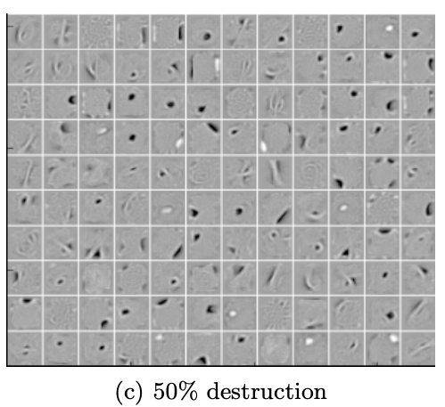
Stronger “feature destruction” leads the network to learn features that look higher-level like blobs and edges.
Vincent, Extracting and Composing Robust Features with Denoising Autoencoders. Proceedings of the 25th International Conference on Machine Learning, Helsinki, Finland, 2008

Slide 21
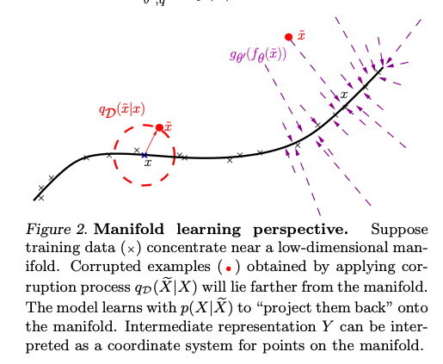
Additive random noise: a way to make the fitted weights more robust.
Analogous to “weight decay” but does not produce identically the same results
“Augmentation” is the general practice of salting the input with automatically-generated training examples derived from real training examples to improve robustness

Slide 22
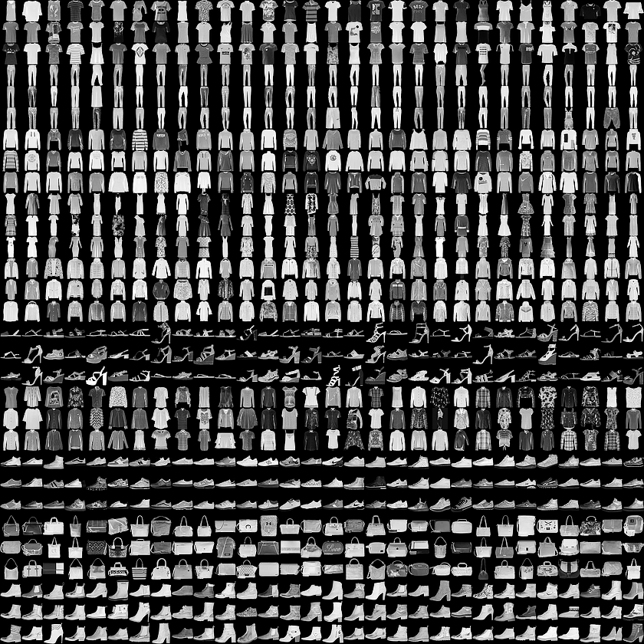
Google Intro to Autoencoders notebook
https://colab.research.google.com/github/tensorflow/docs/blob/master/site/en/tutorials/generative/autoencoder.ipynb
(It ran on my laptop after keras installation; it is probably keeping hundreds of megabytes of test data buried somewhere on my hard drive)

Slide 23
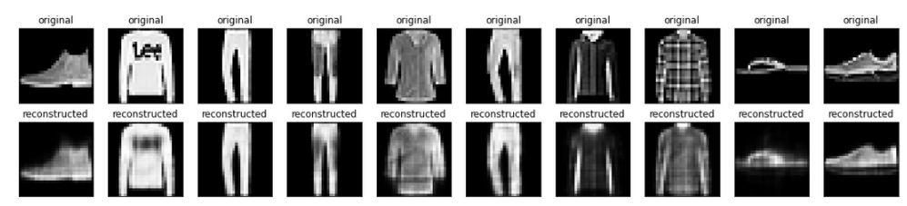

Slide 24
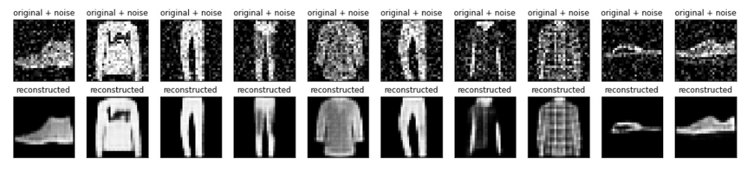

Slide 25
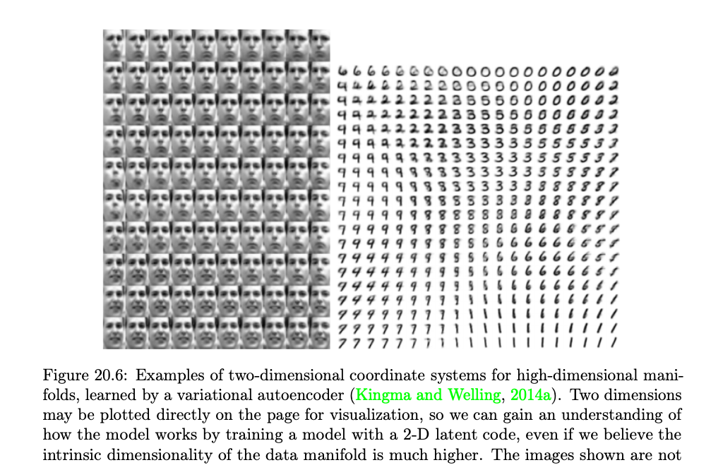

Slide 26
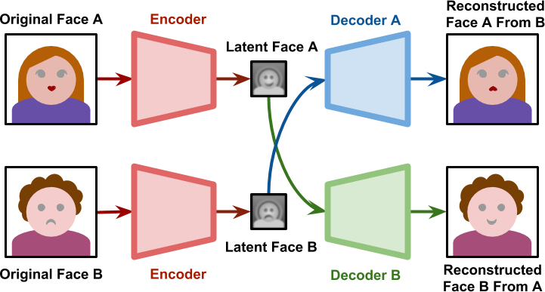
https://stackabuse.com/autoencoders-for-image-reconstruction-in-python-and-keras/

Slide 27
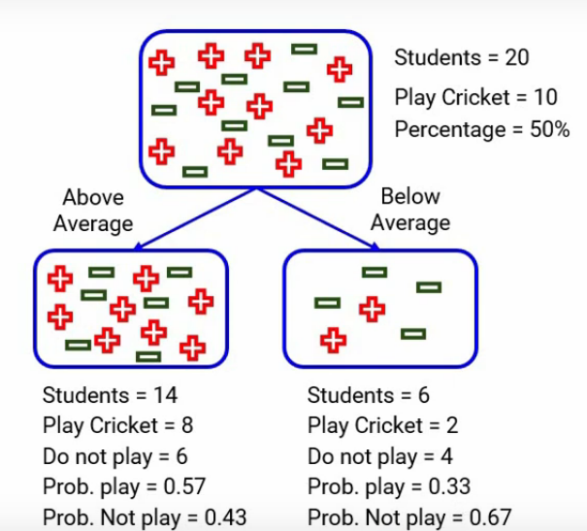
https://www.analyticsvidhya.com/blog/2021/03/how-to-select-best-split-in-decision-trees-gini-impurity/

